Slide 1

PUBG
Final Placement Predictor
ALIVE 100
KILLED 0
CMPE 255 FINAL PROJECT
STORE
LUCK ROYALE
CHARACTER
VAULT
Instructor: Gheorghi Guzun
PET
COLLECTION
START

Slide 2
OUR TEAM
Yashvi Desai
Sai Prasanth
Vineeth Reddy
Pavan Nageswar Reddy
ALIVE 94
KILLED 6
GROUP 5: Data Detectives

Slide 3
01
05
02
04
03
ALIVE 90
KILLED 10
Results
Introduction
Goal
Proposed methodology
EDA

Slide 4
INTRODUCTION
ALIVE 86
KILLED 14
PUBG (PlayerUnknown's Battlegrounds) is an online multiplayer battle royale game where players fight to be the last one standing on a virtual island.
The game was developed and published by PUBG Corporation, a subsidiary of South Korean video game company Bluehole.
In the game, up to 100 players are airdropped onto a large, open map with no weapons or gear.
Notes:
The players then scavenge for weapons, ammunition, and other items, while avoiding being killed by other players or the shrinking playable area.
The last player or team standing wins the game.

Slide 5
GOAL
ALIVE 84
KILLED 16
To use data mining techniques to build a predictive model that can accurately predict the finishing positions of players in the game
By analyzing the game data we aim to :
Gain insights from the game data to draw correlations
Predict the final placement of the player
Recommend winning strategies to players
Our goal is to use these insights to help the players improve their gaming strategies and improve their chances of winning

Slide 6
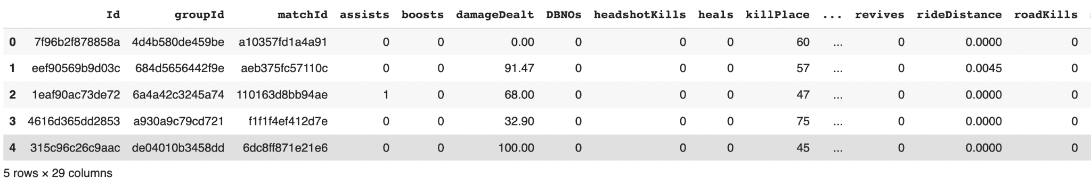
DATASET
ALIVE 80
KILLED 20
Raw dataset link - https://www.kaggle.com/competitions/pubg-finish-placement-prediction/data
We have 29 total features in our data and 4446966 number of rows
Our target attribute is - ‘WinPlacePerc’
PET
COLLECTION

Slide 7
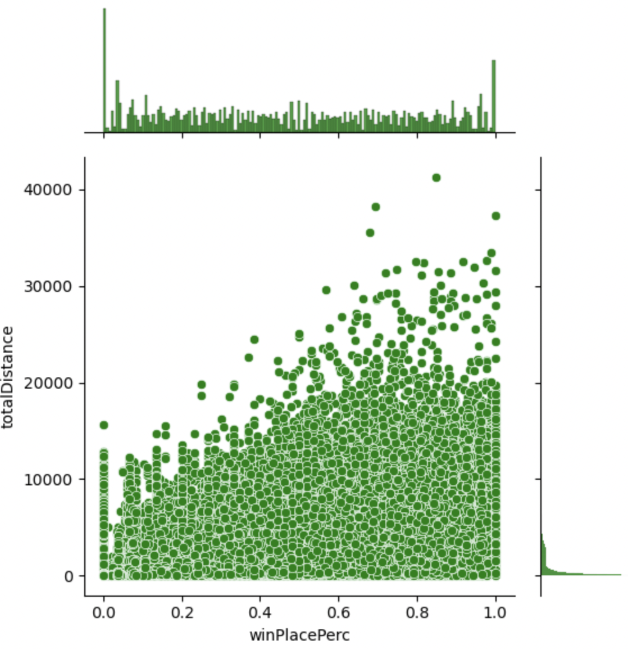
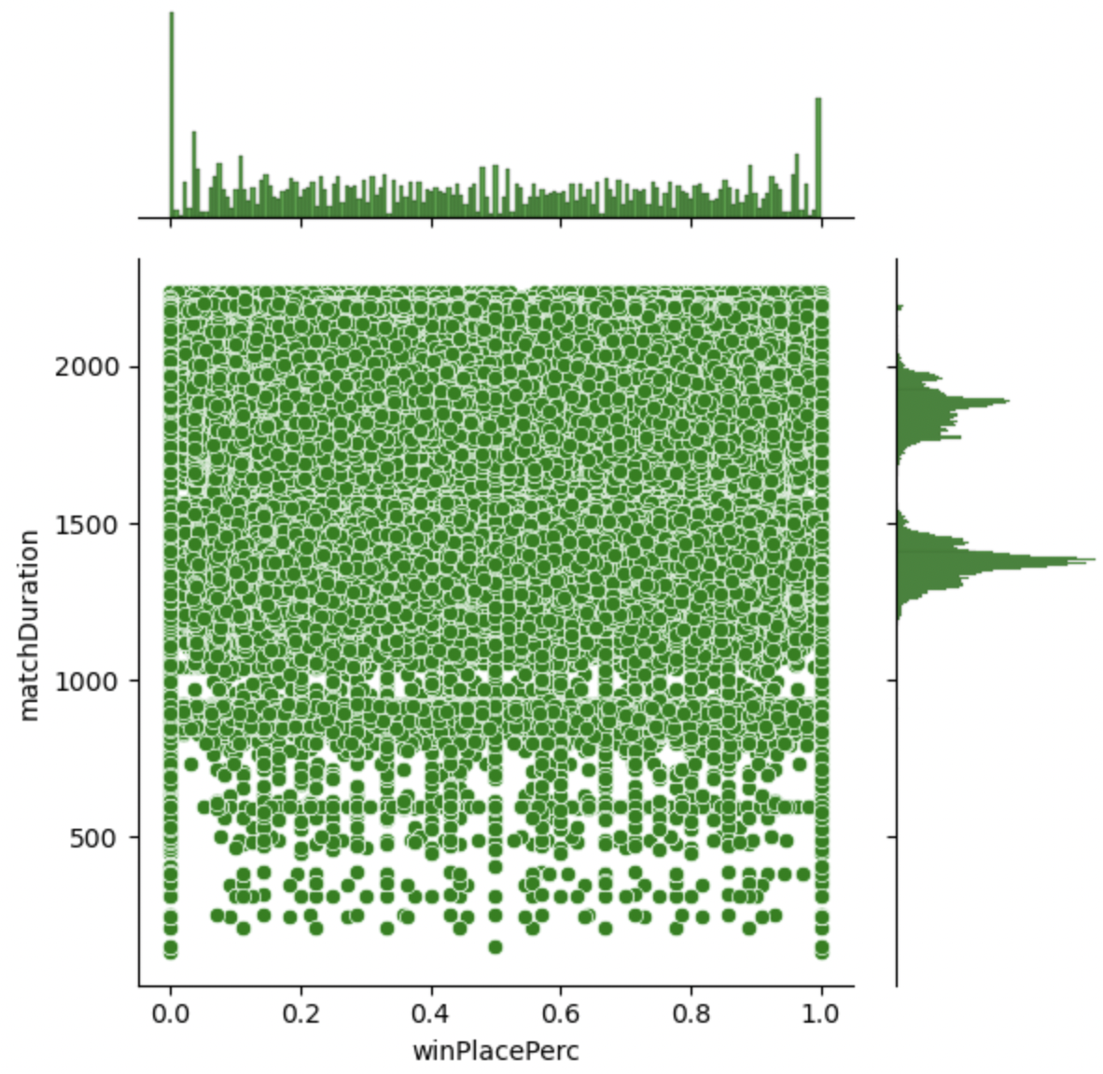
Exploratory Data Analysis
ALIVE 74
KILLED 26
Finding Correlations between the target variable and other features

Slide 8
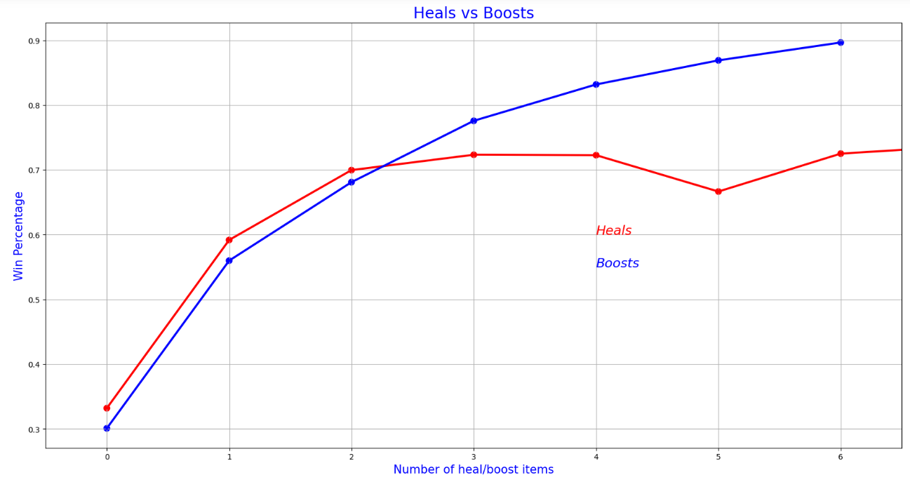
ALIVE 70
KILLED 30

Slide 9
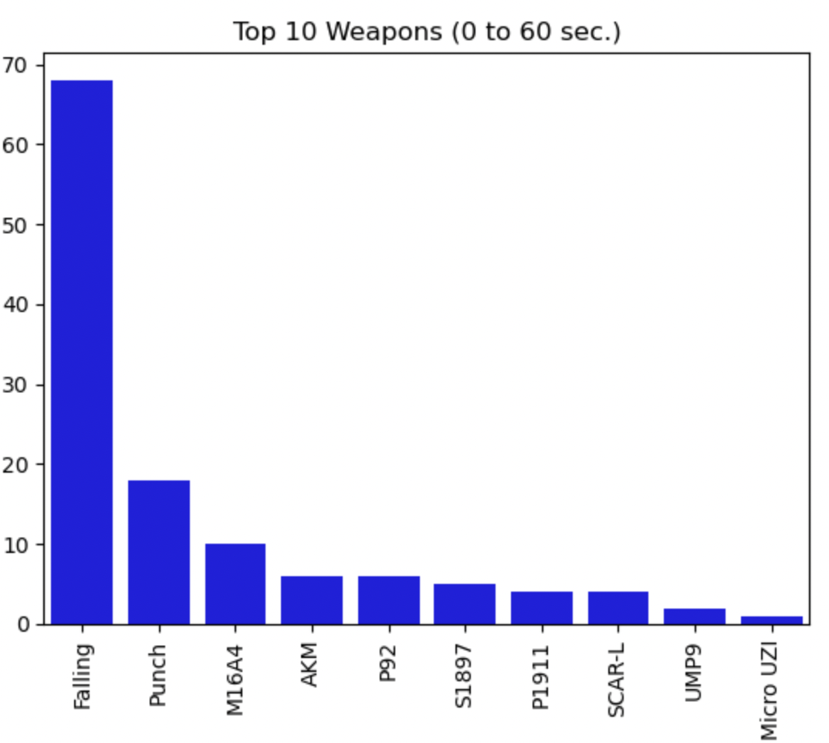
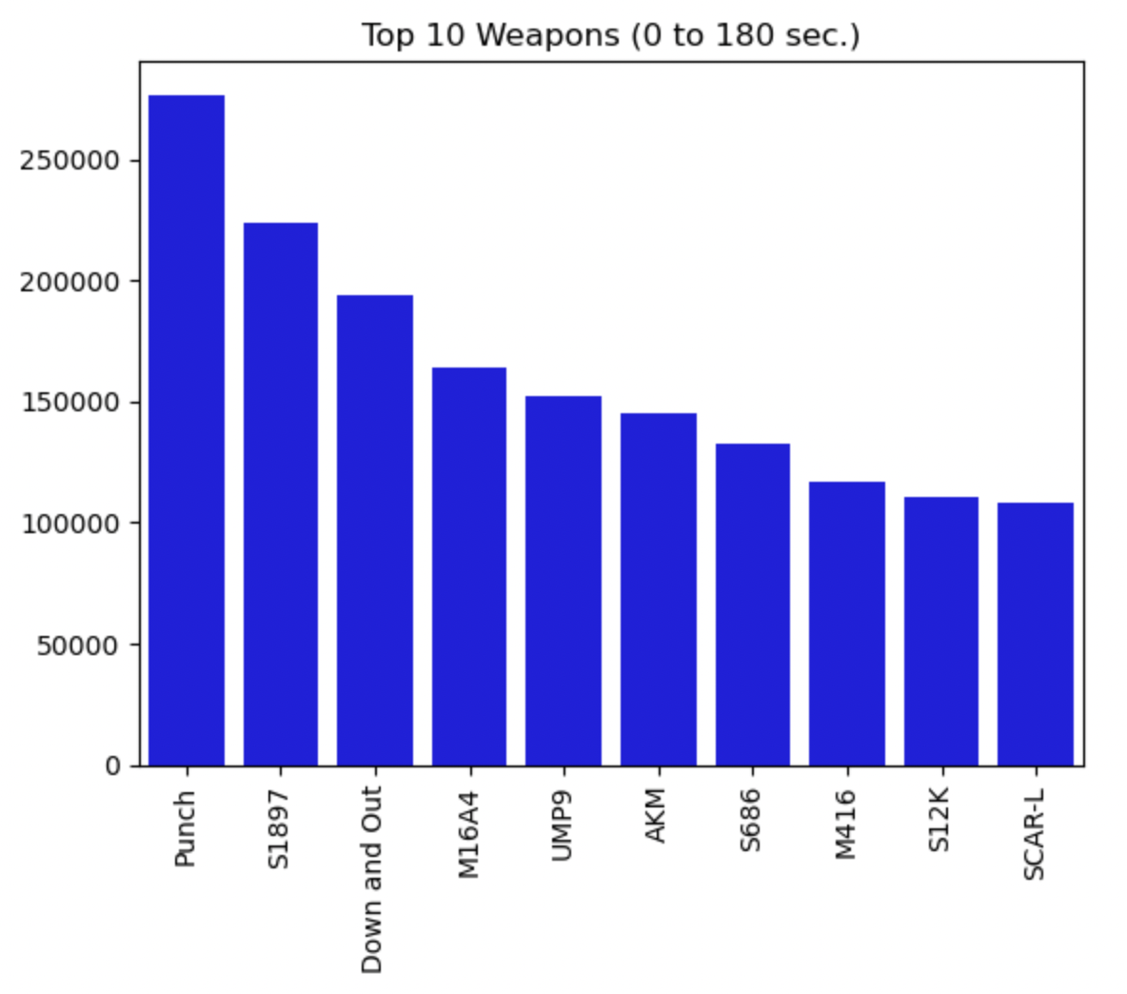
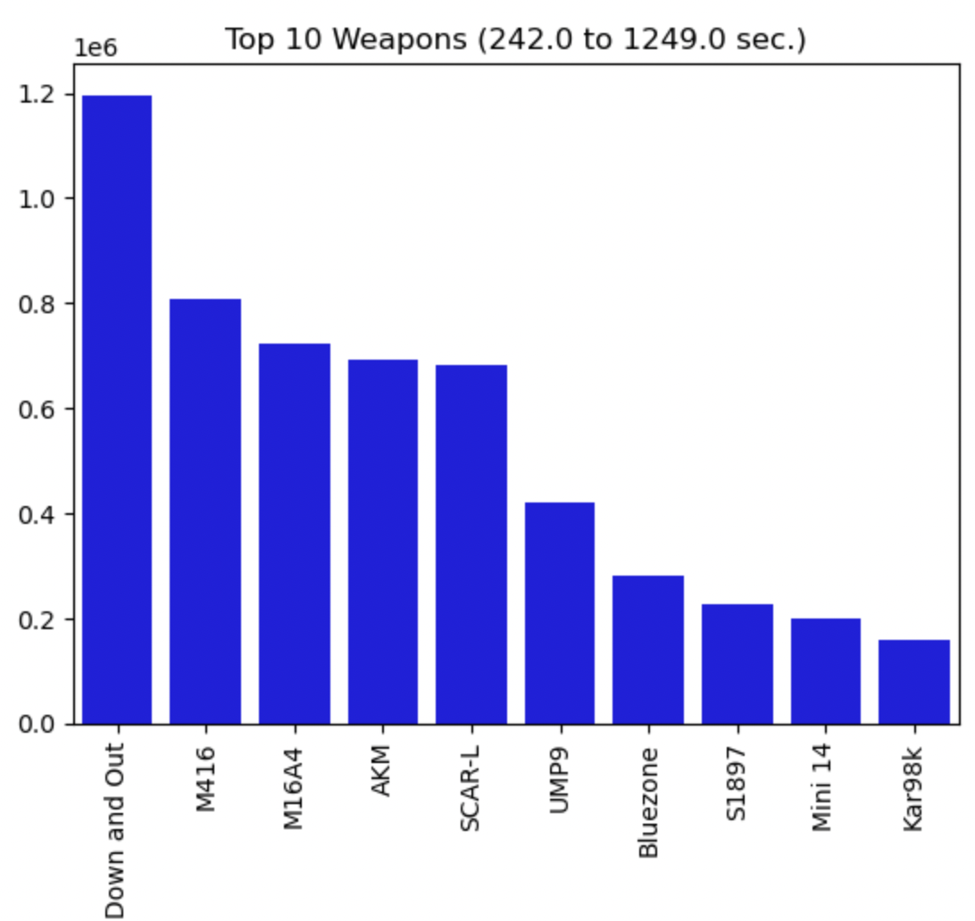
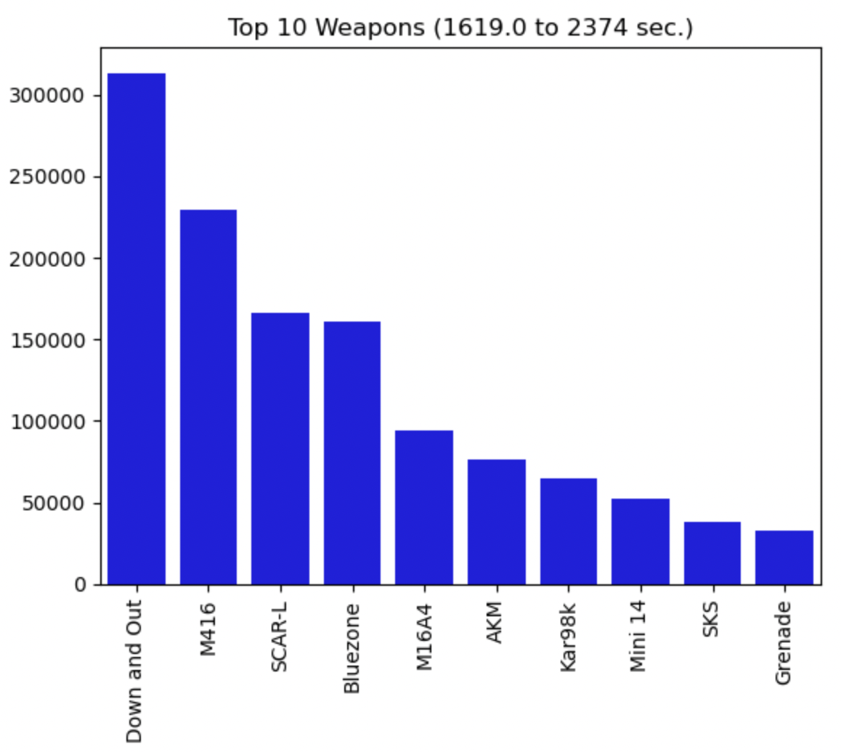
ALIVE 65
KILLED 35
Top 10 Weapons used at the each stage of game
First Minute
First 3 minutes
Middle of the game
Final Stage of the game

Slide 10
ALIVE 57
KILLED 43
72
2237 sec
64
Highest Kills
Longest Game
Most Headshots
3823 meters
25780 meters
Longest Distance Swam
Longest Distance Walked

Slide 11
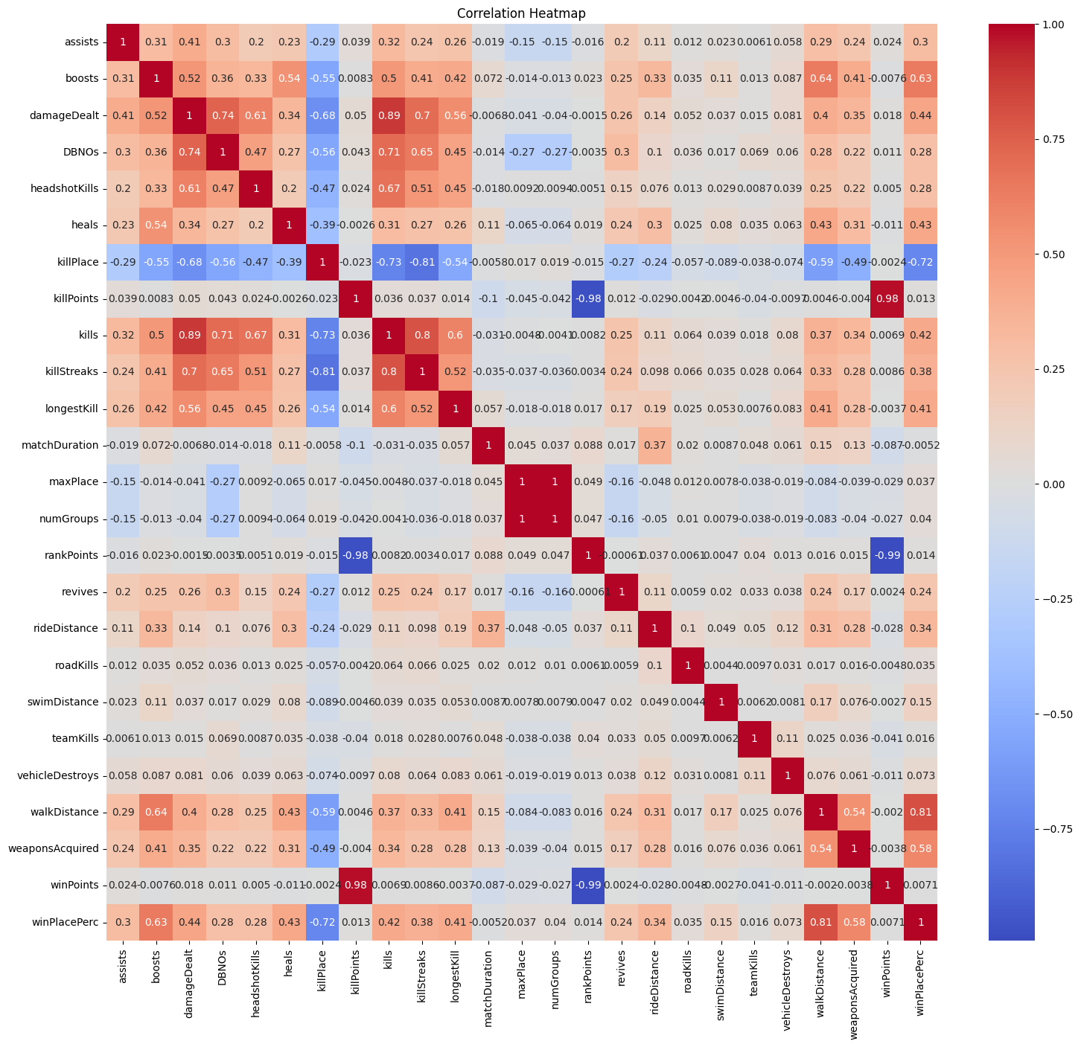
Correlation HeatMap
ALIVE 52
KILLED 48

Slide 12
Algorithm & Methodology
ALIVE 46
KILLED 54
Random Forest
MLP Regressor
Gradient Boosting
XGBoost Regressor
AdaBoost Regressor
K Nearest Neighbors

Slide 13
Random Forest
ALIVE 38
KILLED 62
It is an ensemble learning method that combines multiple decision trees to make more accurate predictions.
Each decision tree in the random forest model is trained independently using a subset of the data and a random subset of the features.
The final prediction is made by taking the average of the predictions made by each decision tree in the random forest.
How to choose n_components ?

Slide 14
Gradient Boosting
ALIVE 32
KILLED 68
It is an ensemble learning method that combines multiple weak learners to create a strong learner.
The final prediction is made by taking the weighted average of the predictions made by each decision tree.
It can handle numerical and categorical data and automatically detect feature interactions.

Slide 15
Question
ALIVE 32
KILLED 68
What is the difference between Random Forest Regressor and Gradient Boosting Regression ?

Slide 16
MLP Regressor
ALIVE 28
KILLED 72
MLP Regressor consists of an input layer, one or more hidden layers, and an output layer.
The output layer produces the final prediction, which is a continuous value rather than a categorical value.
MLP Regressor requires a large amount of training data and may take longer to train than other regression algorithms.
It may overfit the data if the number of training samples is small.
Hidden layer, number of iterations !

Slide 17
K-Nearest Neighbors
ALIVE 23
KILLED 77
The algorithm memorizes the training data.
The prediction is made by finding the K closest neighbours to the input point and averaging their target values.
The algorithm can work well with small datasets or datasets with noisy data.

Slide 18
XGBoost Regressor
ALIVE 14
KILLED 86
XGBoost stands for "Extreme Gradient Boosting", and it is a powerful implementation of the gradient boosting algorithm.
XGBoost uses a combination of multiple decision trees, each of which is trained to minimize the residual error of the previous tree.
It involves optimizing several hyperparameters such as the number of trees, the maximum depth of each tree, and the regularization term to prevent overfitting.

Slide 19
PERFORMANCE COMPARISON
ALIVE 8
KILLED 92
Model | Mean Squared Error | R2 Score
Random Forest | 0.0240 | 0.7439
K Nearest Neighbors | 0.0251 | 0.7336
XGBoost Regressor | 0.0206 | 0.7815
Gradient Boosting | 0.0084 | 0.9104
LightGBM Regressor | 0.0207 | 0.7805
AdaBoost Regressor | 0.0338 | 0.6352
MLP Regressor | 0.0212 | 0.7812

Slide 20
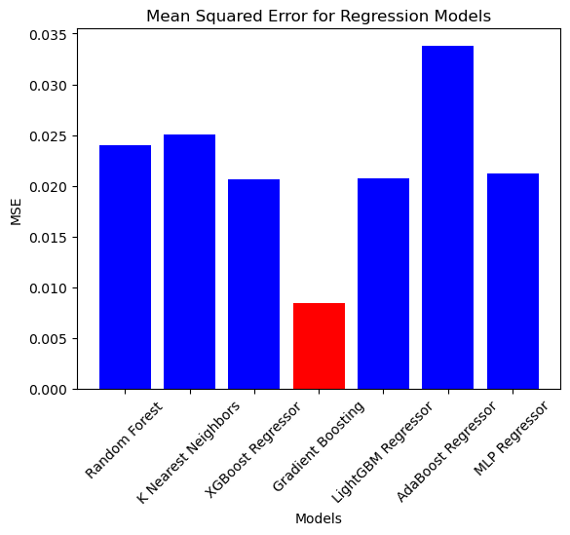
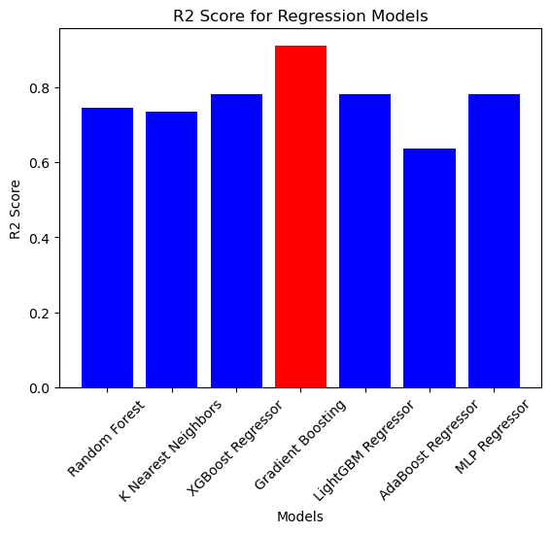
Performance Comparison

Slide 21
CONCLUSION
ALIVE 2
KILLED 98
From the results, we can see that Gradient Boosting has the lowest MSE of 0.0084 and the highest R2 score of 0.9104, indicating that it has the best performance among the models tested.
XGBoost Regressor and MLP Regressor also have good performance with R2 scores of 0.7815 and 0.7812, respectively. Random Forest, K Nearest Neighbors, LightGBM Regressor, and AdaBoost Regressor have lower R2 scores and higher MSE values, indicating poorer performance compared to the other models.

Slide 22
Thank you!
ALIVE 1
KILLED 99

